Slide 1

Basic Details of the Team and Problem Statement
Ministry/Organization Name/Student Innovation:
Ministry of Commerce and Industries
PS Code: SIH1385
Problem Statement Title: Developing a software that can translate resource material and other texts from English to other Indian regional languages
Team Name: Team 404
Team Leader Name: Mustafa Masuldar
Institute Code (AISHE): C-15716
Institute Name: N. B. Navale Sinhgad College of Engineering , Solapur.
Theme Name: Smart Education

Slide 2
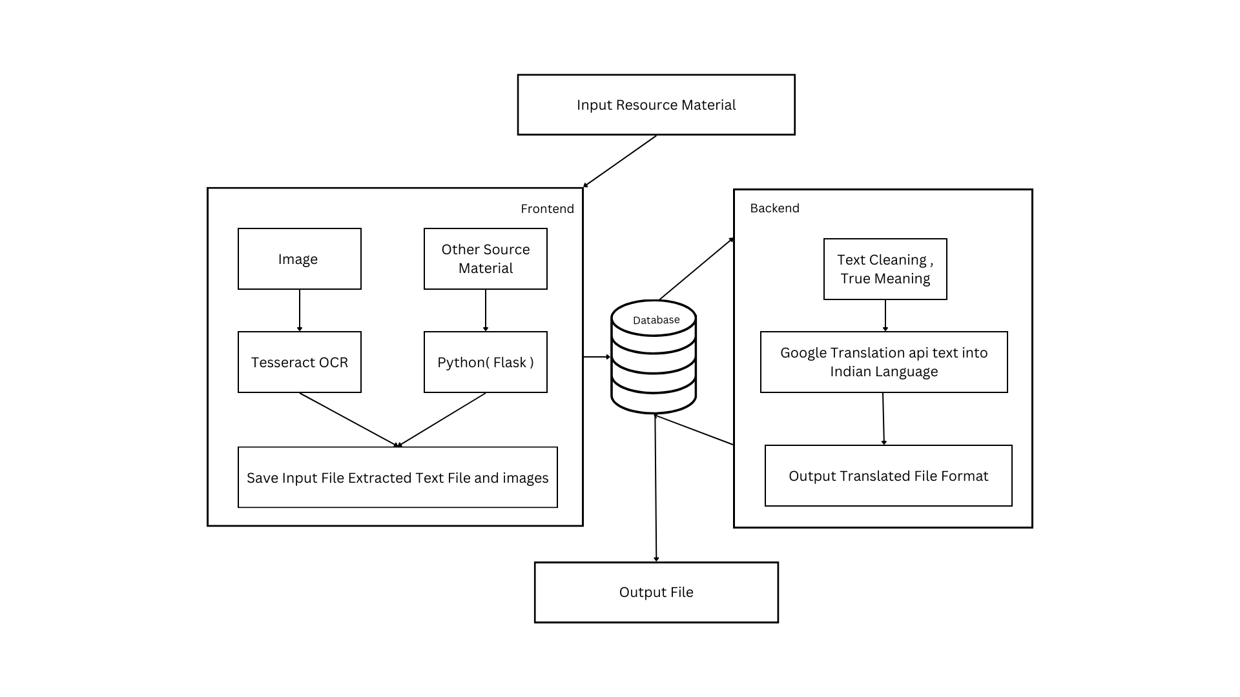
Idea/Approach Details
Describe your idea/Solution/Prototype here:
Vision: Developing software that dismantles language barriers, facilitating effortless translation of resources and texts from English to diverse Indian languages. This promotes widespread knowledge access, fosters cultural inclusivity, and bridges gaps.
Mission: Our mission is to enable seamless communication and information access, transcending linguistic barriers. We achieve this by translating resource materials and texts into various Indian regional languages, promoting inclusivity, and disseminating knowledge across diverse linguistic communities.
Bridging Language Barriers: Make knowledge accessible to a wider audience by eliminating language obstacles
Continuous Improvement: Dedicate to ongoing research and development, staying current with linguistic advancements
Privacy and Data Security: Prioritize user data security, adhering to best practices and data protection regulations.
Describe your Technology stack here:
Google Cloud Translation API
Tesseract OCR
Flask( Framework )
Python libraries
PHP
HTML, CSS, JS

Slide 3
Idea/Approach Details
Describe your Use Cases here
Educational Content Translation:
Translate educational materials, textbooks from English into various Indian languages, making quality education more accessible to non-English-speaking students.
Government and Public Services:
Translate government announcements, public service information, and official documents into regional languages to ensure that citizens have access to critical information in their native languages.
Multilingual Communication:
Facilitate communication between individuals or businesses that speak different languages by providing real-time translation of written text in emails, chat messages, or documents.
Describe your Dependencies / Show stopper here
Dependencies:
Source Material
Show Stoppers:
Data Security and Privacy
Translation Quality
Scalability
User Adoption and Feedback
Technical Challenges
Resource Constraints

Slide 4
Team Member Details
Team Leader Name : Mustafa Masuldar
Branch : Btech Stream : CSE Year : IV
Team Member 1 Name : Sakshi Deshmukh
Branch : Btech Stream : CSE Year : IV
Team Member 2 Name : Pooja Pawar
Branch : Btech Stream : CSE Year : IV
Team Member 3 Name : Nandini Madre
Branch : Btech Stream : CSE Year : IV
Team Member 4 Name : Iram Muchale
Branch : Btech Stream : CSE Year : IV
Team Member 5 Name: Nikita Jagdale
Branch : Btech Stream : CSE Year : III

